Slide 1
Cryptography (2021 Fall) index of coincidence, principles of modern cryptography, security guarantee, threat model, COA, KPA, CPA, CCA
LiangFeng Zhang
zhanglf@shanghaitech.edu.cn
SIST, ShanghaiTech

Slide 2
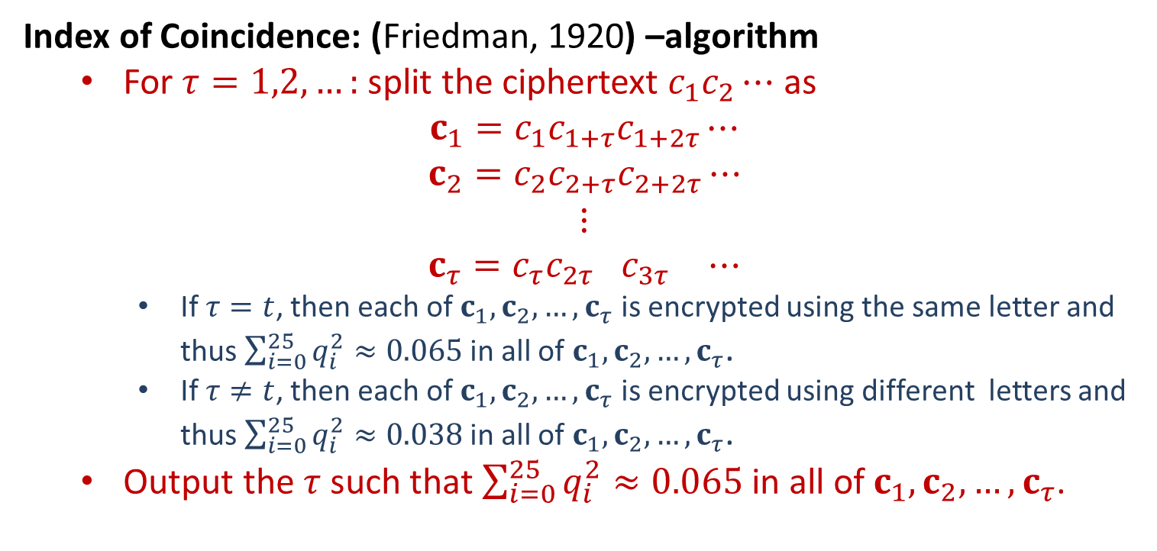
Attacks
Index of Coincidence: (Friedman, 1920) –algorithm
For $τ=1,2,…:$ split the ciphertext $c_{1}c_{2}⋯$ as
$${c_{1}=c}_{1}c_{1+τ}c_{1+2τ}⋯$$
$${c_{2}=c}_{2}c_{2+τ}c_{2+2τ}⋯$$
$$⋮$$
$${c_{τ}=c}_{τ}c_{2τ+ }c_{3τ+ }⋯$$
If $τ=t$, then each of $c_{1},c_{2},…,c_{τ}$ is encrypted using the same letter and thus $\sum_{i=0}^{25}{q_{i}^{2}≈0.065}$ in all of$c_{1},c_{2},…,c_{τ}$.
If $τ≠t$, then each of $c_{1},c_{2},…,c_{τ}$ is encrypted using different letters and thus $\sum_{i=0}^{25}{q_{i}^{2}≈0.038}$ in all of$c_{1},c_{2},…,c_{τ}$.
Output the $τ$ such that $\sum_{i=0}^{25}{q_{i}^{2}≈0.065}$ in all of $c_{1},c_{2},…,c_{τ}$.

Slide 3
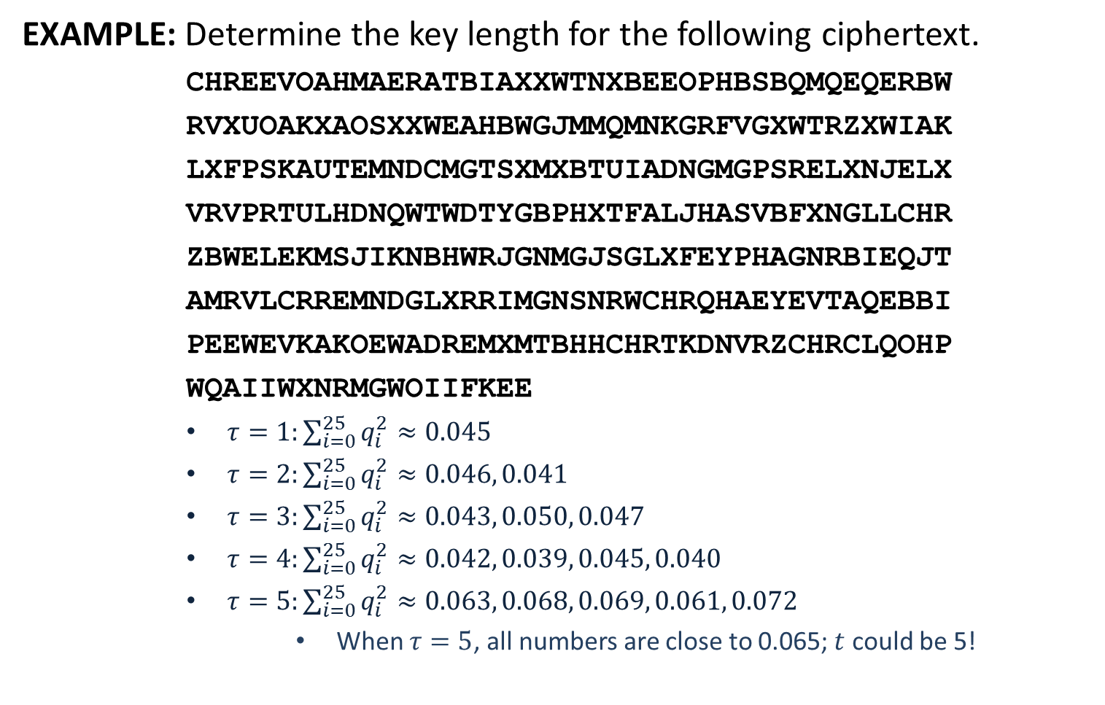
Attacks
EXAMPLE: Determine the key length for the following ciphertext.
CHREEVOAHMAERATBIAXXWTNXBEEOPHBSBQMQEQERBW
RVXUOAKXAOSXXWEAHBWGJMMQMNKGRFVGXWTRZXWIAK
LXFPSKAUTEMNDCMGTSXMXBTUIADNGMGPSRELXNJELX
VRVPRTULHDNQWTWDTYGBPHXTFALJHASVBFXNGLLCHR
ZBWELEKMSJIKNBHWRJGNMGJSGLXFEYPHAGNRBIEQJT
AMRVLCRREMNDGLXRRIMGNSNRWCHRQHAEYEVTAQEBBI
PEEWEVKAKOEWADREMXMTBHHCHRTKDNVRZCHRCLQOHP
WQAIIWXNRMGWOIIFKEE
$τ=1:\sum_{i=0}^{25}{q_{i}^{2}}≈0.045$
$τ=2:\sum_{i=0}^{25}{q_{i}^{2}}≈0.046, 0.041$
$τ=3:\sum_{i=0}^{25}{q_{i}^{2}}≈0.043, 0.050, 0.047$
$τ=4:\sum_{i=0}^{25}{q_{i}^{2}}≈0.042, 0.039, 0.045, 0.040$
$τ=5:\sum_{i=0}^{25}{q_{i}^{2}}≈0.063, 0.068, 0.069, 0.061, 0.072$
When $τ=5$, all numbers are close to 0.065; $t$ could be 5!

Slide 4
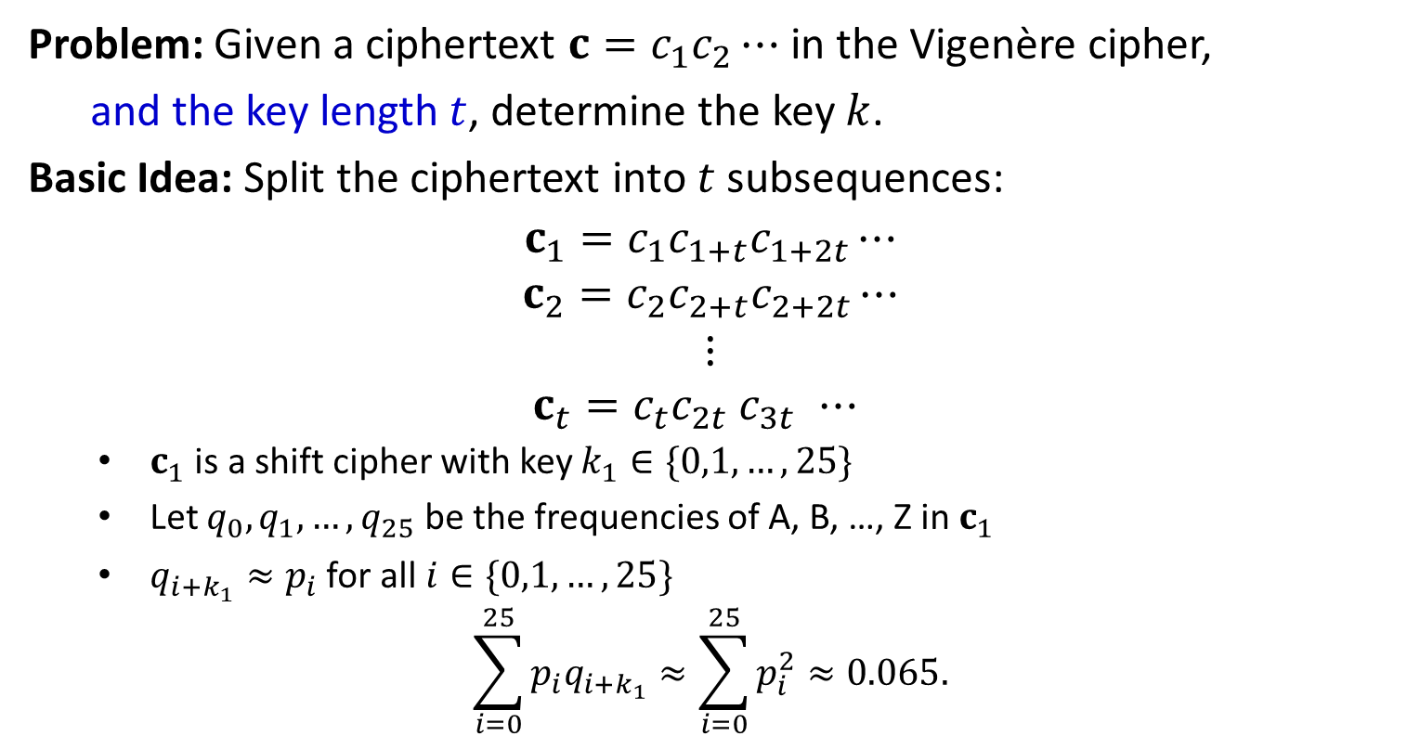
Attacks
Problem: Given a ciphertext ${c=c}_{1}c_{2}⋯$ in the Vigenère cipher,
and the key length $t$, determine the key $k$.
Basic Idea: Split the ciphertext into $t$ subsequences:
$${c_{1}=c}_{1}c_{1+t}c_{1+2t}⋯$$
$${c_{2}=c}_{2}c_{2+t}c_{2+2t}⋯$$
$$⋮$$
$${c_{t}=c}_{t}c_{2t} c_{3t }⋯$$
$c_{1}$ is a shift cipher with key $k_{1}∈\{0,1,…,25\}$
Let $q_{0},q_{1},…,q_{25}$ be the frequencies of A, B, …, Z in $c_{1}$
$q_{i+k_{1}}≈p_{i}$ for all $i∈\{0,1,…,25\}$
$$\sum_{i=0}^{25}{p_{i}q_{i+k_{1}}}≈\sum_{i=0}^{25}{p_{i}^{2}}≈0.065.$$

Slide 5
Determine the Key
EXAMPLE: Determine the plaintext for the following ciphertext.
CHREEVOAHMAERATBIAXXWTNXBEEOPHBSBQMQEQERBW
RVXUOAKXAOSXXWEAHBWGJMMQMNKGRFVGXWTRZXWIAK
LXFPSKAUTEMNDCMGTSXMXBTUIADNGMGPSRELXNJELX
VRVPRTULHDNQWTWDTYGBPHXTFALJHASVBFXNGLLCHR
ZBWELEKMSJIKNBHWRJGNMGJSGLXFEYPHAGNRBIEQJT
AMRVLCRREMNDGLXRRIMGNSNRWCHRQHAEYEVTAQEBBI
PEEWEVKAKOEWADREMXMTBHHCHRTKDNVRZCHRCLQOHP
WQAIIWXNRMGWOIIFKEE
We guess the key length is 5. Split the ciphertext into 5 sequences:
CVABWEBQBUAWWQRWWXANTBDPXXRDWBFAXCWMNJJFAIACNRNCATBWKDMCDCQQXWK
HOEITESEWOOEGMFTIFUDSTNSNVTNDPASNHESBGSEGEMRDRSHEAIEORTHNHOANOE
RARANOBQRASAJNVRAPTCXUGRJRUQTHLVGRLJHNGYNQRRGINRYQPVEEBRVRHIRIE
EHAXXPQEVKXHMKGZKSEMMIMEEVLWYXJBLZEIWMLPRJVELMRQEEEKWMHTRCPIMI
EMTXBHMRXXXBMGXXLKMGXAGLLPHTGTHFLBKKRGXHBTLMXGWHVBEAAXHKZLWWGF

Slide 6

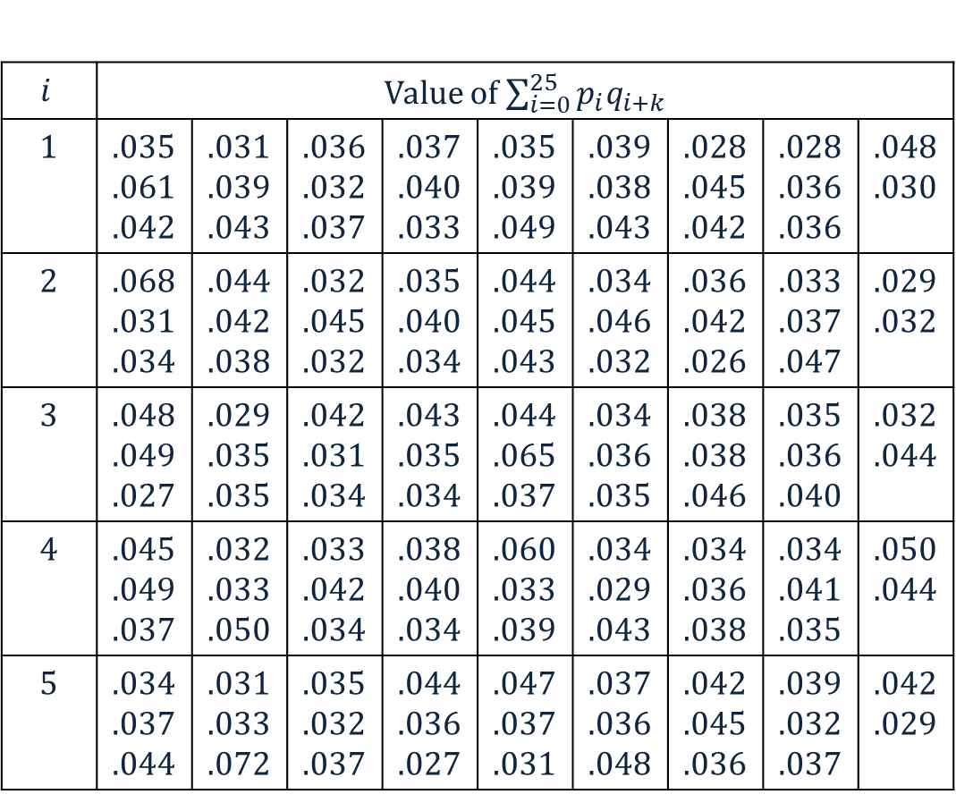
Determine the Key
$$i$$ | Value of $\sum_{i=0}^{25}{p_{i}q_{i+k}}$
1 | .035 .061 .042 | .031 .039 .043 | .036 .032 .037 | .037 .040 .033 | .035 .039 .049 | .039 .038 .043 | .028 .045 .042 | .028 .036 .036 | .048 .030
2 | .068 .031 .034 | .044 .042 .038 | .032 .045 .032 | .035 .040 .034 | .044 .045 .043 | .034 .046 .032 | .036 .042 .026 | .033 .037 .047 | .029 .032
3 | .048 .049 .027 | .029 .035 .035 | .042 .031 .034 | .043 .035 .034 | .044 .065 .037 | .034 .036 .035 | .038 .038 .046 | .035 .036 .040 | .032 .044
4 | .045 .049 .037 | .032 .033 .050 | .033 .042 .034 | .038 .040 .034 | .060 .033 .039 | .034 .029 .043 | .034 .036 .038 | .034 .041 .035 | .050 .044
5 | .034 .037 .044 | .031 .033 .072 | .035 .032 .037 | .044 .036 .027 | .047 .037 .031 | .037 .036 .048 | .042 .045 .036 | .039 .032 .037 | .042 .029
$K=\left(9,0,13,4,19\right)=$JANET

Slide 8
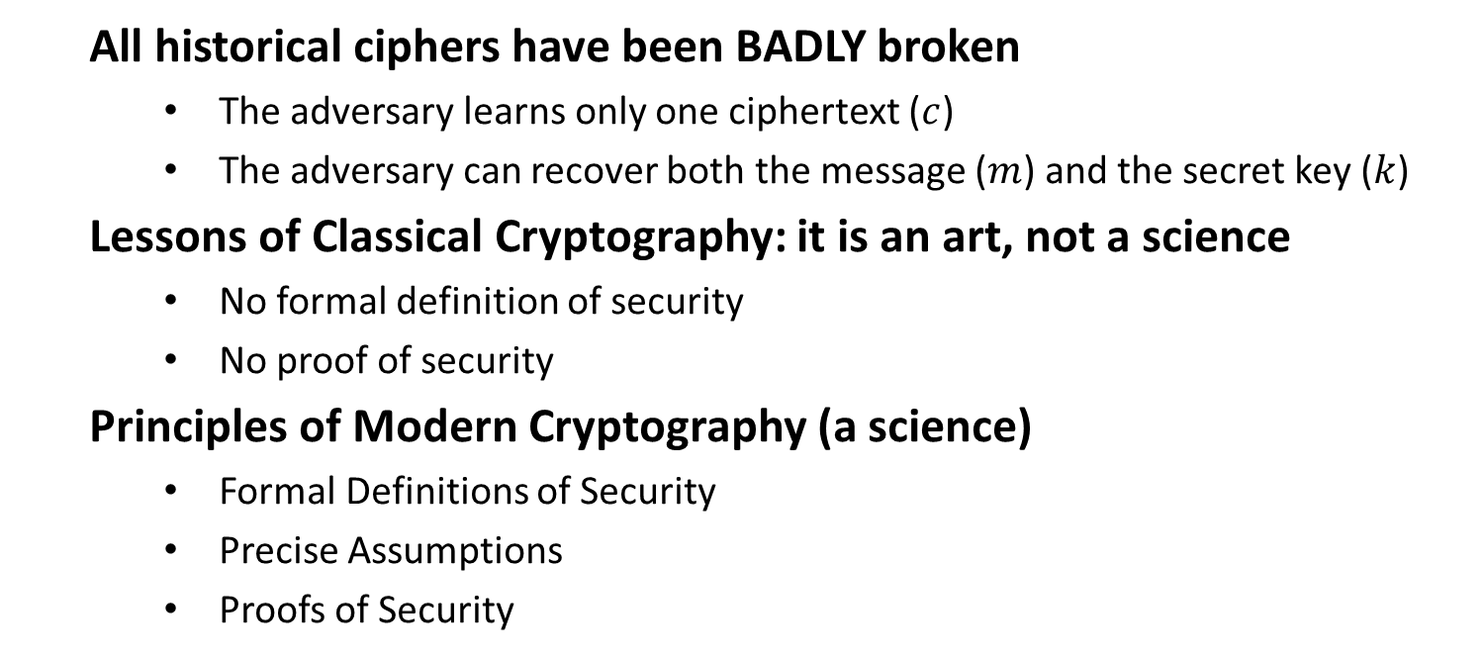
Classical & Modern Cryptography
All historical ciphers have been BADLY broken
The adversary learns only one ciphertext ($c$)
The adversary can recover both the message ($m$) and the secret key ($k$)
Lessons of Classical Cryptography: it is an art, not a science
No formal definition of security
No proof of security
Principles of Modern Cryptography (a science)
Formal Definitions of Security
Precise Assumptions
Proofs of Security

Slide 9
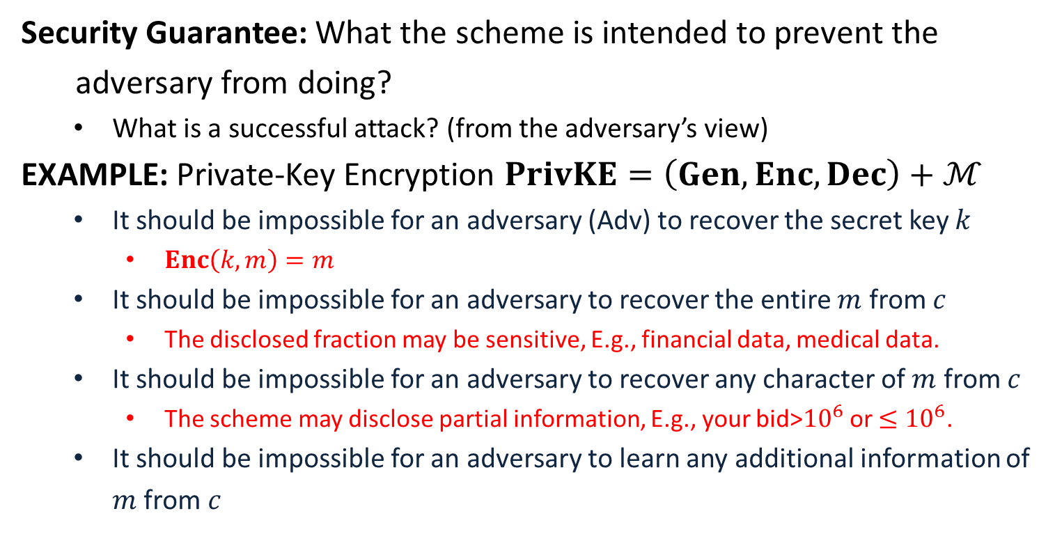
Formal Definitions of Security
Security Guarantee: What the scheme is intended to prevent the
adversary from doing?
What is a successful attack? (from the adversary’s view)
EXAMPLE: Private-Key Encryption $PrivKE=\left(Gen, Enc, Dec\right)+ℳ$
It should be impossible for an adversary (Adv) to recover the secret key $k$
$Enc\left(k,m\right)=m$
It should be impossible for an adversary to recover the entire $m$ from $c$
The disclosed fraction may be sensitive, E.g., financial data, medical data.
It should be impossible for an adversary to recover any character of $m$ from $c$
The scheme may disclose partial information, E.g., your bid>${10}^{6}$ or $≤{10}^{6}$.
It should be impossible for an adversary to learn any additional information of $m$ from $c$
Insecure! The entire plaintext is disclosed to the adversary.
This is a good security guarantee.

Slide 10
Formal Definitions of Security
Threat Model: What actions the adversary is assumed able to carry out
defines the power of the adversary
EXAMPLE: The typical threat models for private-key encryption
Ciphertext-Only Attack (COA):
The adversary observes a ciphertext (or multiple ciphertexts) .
It tries to determine information about the underlying plaintext (or plaintexts).
Shift cipher, substitution cipher and Vigenère Cipher are all broken with COA.
Known-Plaintext Attack (KPA):
The adversary learns one or more pairs of plaintext and ciphertext generated using some key.
It tries to determine information about the underlying plaintext of some other ciphertext produced using the same key.
All historical ciphers are trivial to break with KPA.

Slide 11
Formal Definitions of Security
Chosen-Plaintext Attack (CPA):
The adversary obtains plaintext/ciphertext pairs for plaintexts of its choice.
It tries to determine information about the underlying plaintext of some other ciphertext produced using the same key.
Chosen-Ciphertext Attack (CCA):
The adversary obtains plaintext/ciphertext pairs for plaintexts of its choice and ciphertext/plaintext pairs for ciphertexts of its choice.
It tries to determine information about the underlying plaintext of some other ciphertext produced using the same key.
A Security Definition Looks Like: A cryptographic scheme for a given
task is secure if no adversary of a specific power can achieve a
specified break.

Slide 12
Precise Assumptions
Assumption: Statements that are not proven but conjectured to be true
EXAMPLE: The integer factoring problem is hard.
RSA public encryption; Paillier’s Encryption; …
EXAMPLE: The discrete logarithm problem is hard.
ElGamal encryption; BGN encryption
Modern cryptographic constructions are based on assumptions
Why Precise Assumptions:
Not precise, cannot be studied well, cannot establish confidence
Facilitate the comparison of schemes with different assumptions
Understanding the necessary assumptions

Slide 13
Proofs of Security
Provable Security: If the designed cryptographic scheme can be broken
by an adversary, then the underlying assumption is false.
Proof is relative to the security definition and the assumption
A Theorem Looks like: Assume that X is true (e.g., certain problem is
hard), scheme Y is secure according to the given definition.
A Proof Looks like: Given an adversary A that breaks the scheme Y
according to the definition, using A we can construct something
that falsifies X (solve the problem related to X).

